Slide 1
Facial Recognition using Python
By- Ashish Jayaram (1MS17IS029)
Gagan N. Gowda (1MS17IS043)
Reshma S. (1MS17IS088)
M. Bharat Kumar (1MS17IS59)

Slide 2
Problem Statement
Whenever you upload a new photo to facebook you will see that facebook recognises your friends faces with names. Here, facebook uses a image processing algorithm which we will discuss in this project
→Whenever you go to your school, college or office they rely on conventional attendance recording techniques. Some offices and educational institutions use fingerprint scanners, which is slow and has a high tendency to fail in times of winter or rain as the fingerprint cannot be clearly read.
→So here we have a solution for this problem where we have made facial recognition easy by using image processing algorithms and python programing.
→we have a predefined faces of all members of a group or institution such that every time an input image is provided to a system, the system can automatically recognise the person and labels the person and makes a note of it.

Slide 3
Objective and Outcome
Using python’s inbuilt face_recognition library and OpenCV v2 we create a program that helps us detect a set list of faces present in the dataset of known entities across multiple random images. We can use this to determine the presence of a certain person in any given image. This has application in industry such as tagging friends of user on social media, classifying data into groups based on individual, recognising law-breakers from images from cctv footage of crime scene, etc.
The program has a predefined dataset of known entities which it is to identify. When an input image is given, it checks the image for the presence of an entity from the known entities. If there is a match, it draws a face around the matched face and specifies the name of the identified person. It can be used to identify multiple faces in a group.

Slide 4

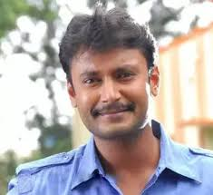
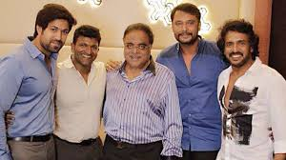
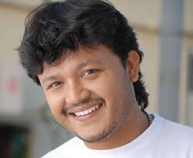

Known Dataset Unknown Dataset
Upendra
Darshan
Unknown
Darshan
Puneeth
Unknown
Upendra
From the known dataset the compiler is obtaining the unknown dataset information and naming them as per the known dataset comparison.
Ganesh
Puneeth

Slide 5
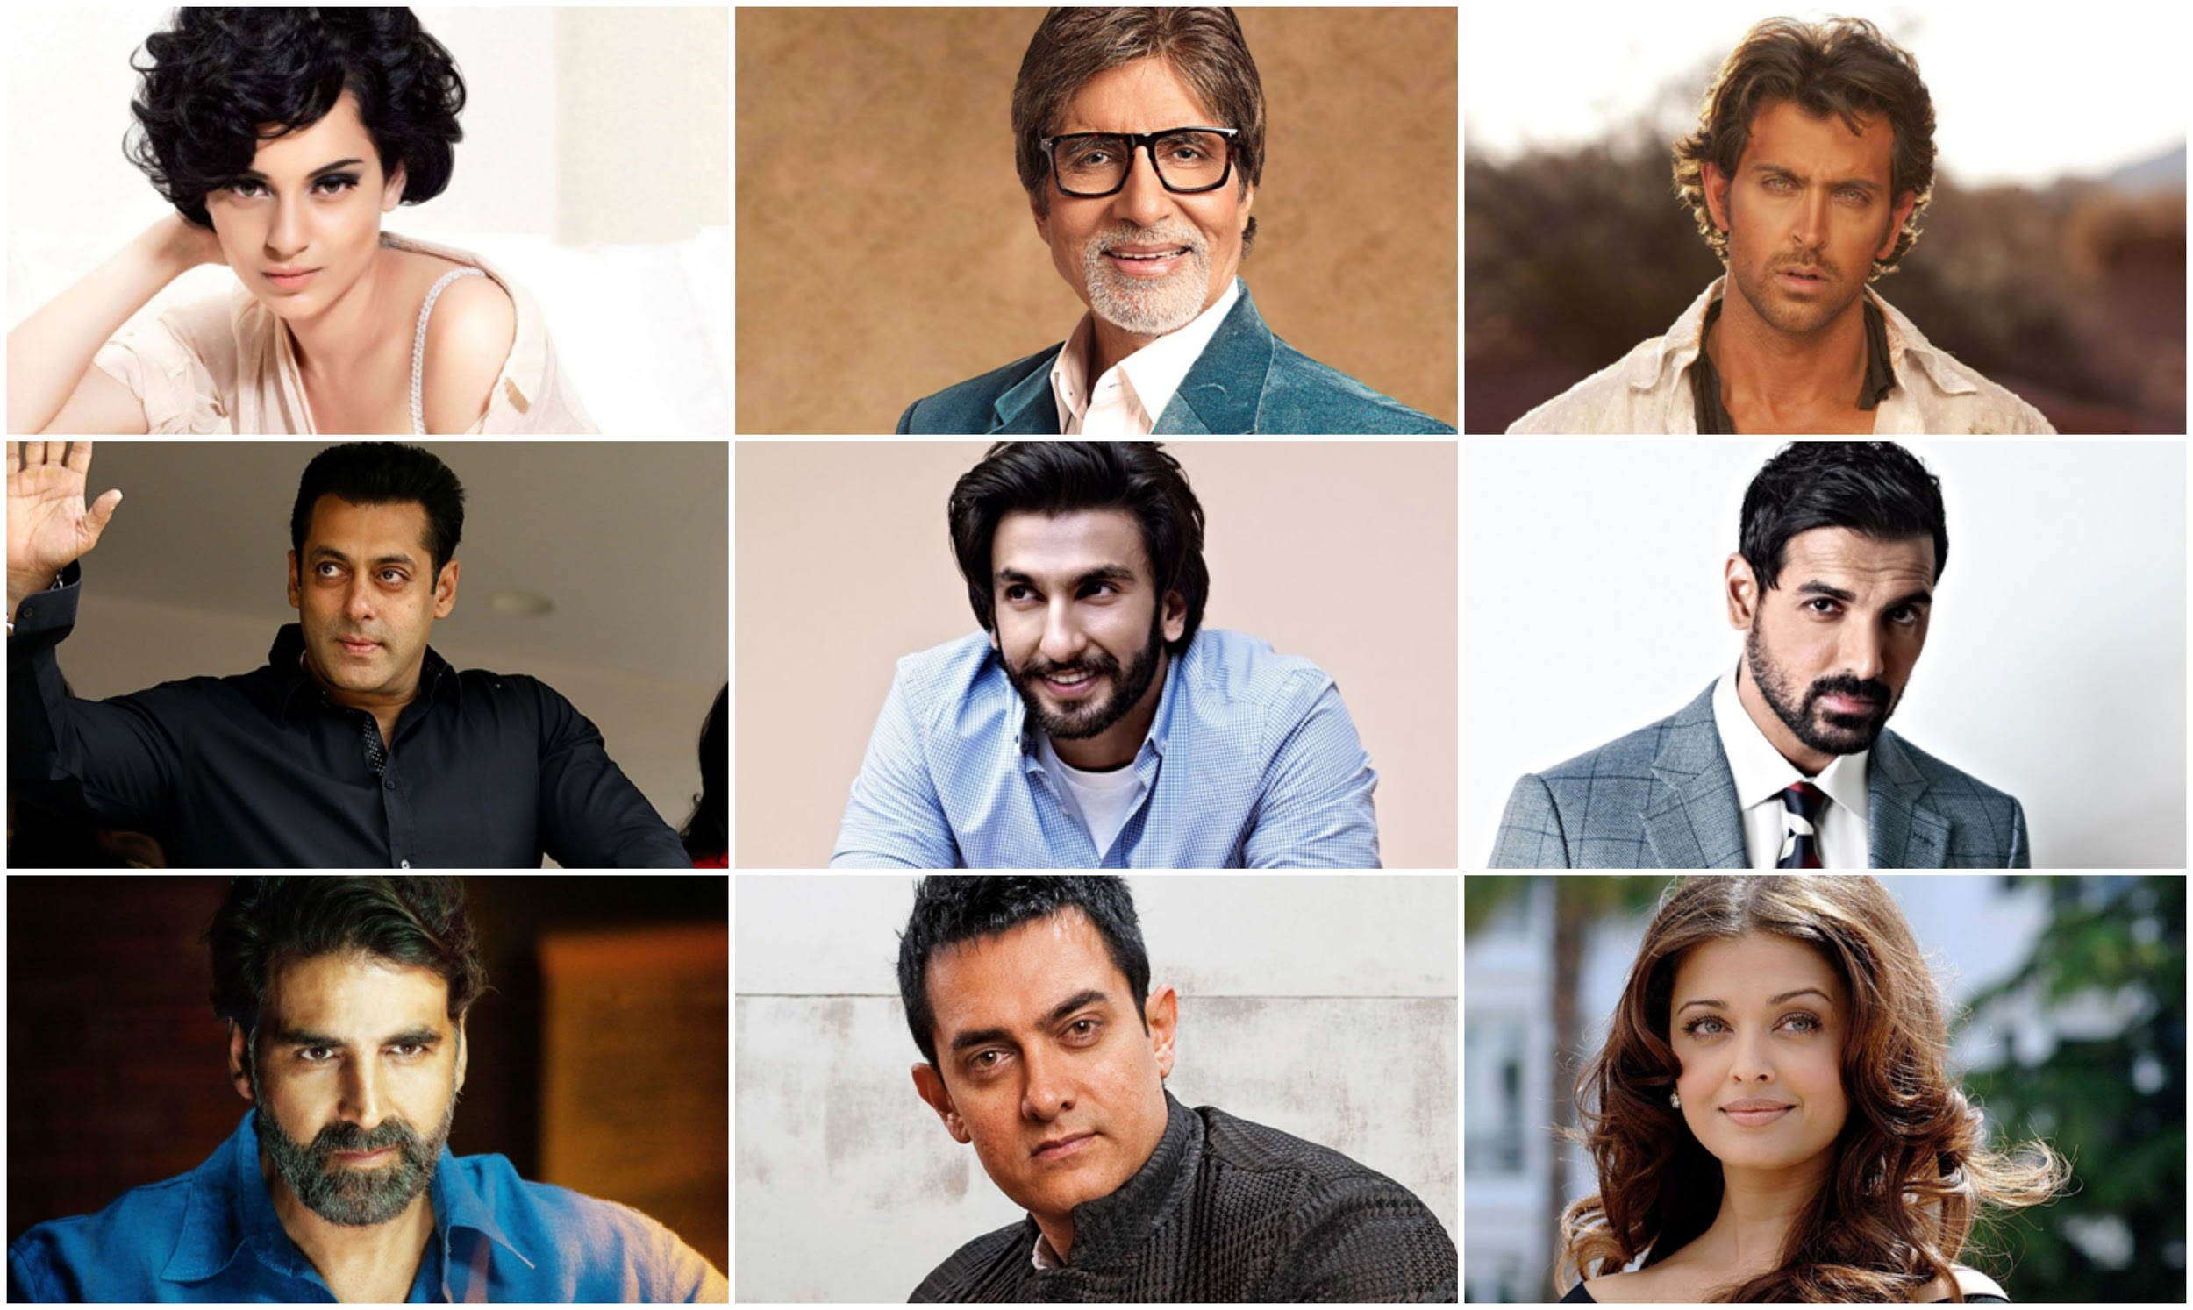
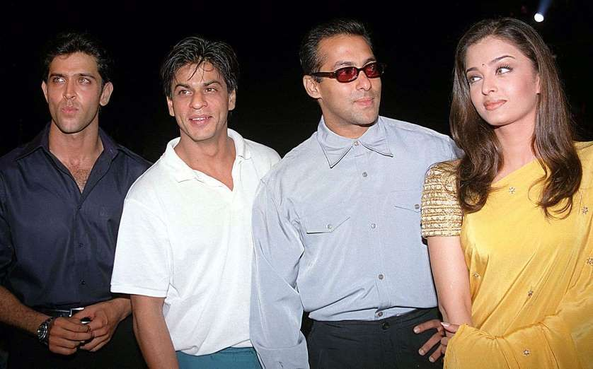
Known Dataset Unknown Dataset
Amithab
HR
HR
Unknown
Salman Khan
Aishwarya
Ranveer Singh
John Abraham
Amir Khan
Aishwarya

Slide 6
LITERATURE SURVEYS

Slide 7
Title : Facial Recognition by manual measurements of Mr. Bledsoe
Method : Bledsoe developed a system that could classify photos of faces by hand using what’s known as a RAND tablet, a device that people could use to input horizontal and vertical coordinates on a grid using a stylus that emitted electromagnetic pulses. The system could be used to manually record the coordinate locations of various facial features including the eyes, nose, hairline and mouth. These metrics could then be inserted in a database. Then, when the system was given a new photograph of an individual, it was able to retrieve the image from the data.
Drawback : At the time, face recognition was unfortunately limited severely by the technology of the era and computer processing power. However, it was an important first step in proving that face recognition was a viable biometric.ase that most closely resembled that individual.
Accuracy : In the 1970s, Goldstein, Harmon, and Lesk were able to add increased accuracy to a manual facial recognition system. They used 21 specific subjective markers including lip thickness and hair color in order to identify faces automatically.

Slide 8
Title : Automatic Face Recognition System.
Method : It’s a one­-to- ­many matching process that compares a query face image against all the template images in a face database to determine the identity of the query face. The identification of the test image is done by locating the image in the database that has the highest similarity with the test image. The identification process is a closed test, which means the sensor takes an observation of an individual that is known to be in the database. The test subject’s (normalized) features are compared to the other features in the system’s database and a similarity score is found for each comparison. These similarities scores are then numerically ranked in a descending order.

Slide 9
Drawbacks : The variations between the images of the same face due to illumination and viewing direction are almost always larger than the image variation due to change in face identity”. This variability makes it difficult to extract the basic information of the face objects from their respective images. Various imaging parameters, such as aperture, exposure time, lens aberrations, and sensor spectral response also increase variations.In field settings, face images are subject to a wide range of variations. These include pose or view angle, illumination, occlusion, facial expression, time delay between image acquisition, and individual differences. The scalability of face recognition systems to such factors is not well understood. Most research has been limited to frontal views obtained under standardized illumination on the same day with absence of occlusion and with neutral facial expression or slight smile.

Slide 10
Accuracy : The performance and classification was not satisfactory. There are several contributing factors. This technique can have good performance under the small lighting variations. All but the MIT database contain significant lighting variations. Again this technique also requires a lot of preprocessing such as background elimination that the images only contain faces.

Slide 11
Title : Local Binary Patterns
Method : The local Binary Pattern is a technique of face detection and recognition using both shape and texture information of an
image it is very effective for image textures. The human face area is segmented into small regions to measure local
binary pattern histogram which is used to recognize image.
Drawbacks : (1) They produce rather long histograms, which slow down the recognition speed especially on large-scale face database; (2) Under some certain circumstance, they miss the local structure as they don't consider the effect of the center pixel; (3) The binary data produced by them are sensitive to noise.

Slide 12
Accuracy : After a lot of study and research that has been widely through by the researchers, it also can be applied in object detection based on other terms and does not only focusing in texture classification.

Slide 13
Title : Eigenfaces method for image recognition
Method : Eigenfaces are a set of standardized face component based on statistical analysis of various face images. Mathematically speaking, Eigenfaces are a set of eigenvectors derived from the covariance matrix of a high dimensional vector that represents possible faces of humans. Any human face can be represented by linear combination of Eigenface images. For example, one person’s face can be represented by some portion of Eigenface of one type and some other portion of Eigenface of another type, and so on. A new face image is projected onto face space simply by multiplying the difference between the image and the average and the result is multiplied by each eigenvector. The result of this operation will be the weighted contribution of each Eigenface in representing the input face image, treating the Eigenfaces as a basis set for face images. The Euclidean distance taken from each face class determines the class that best matches the input image.

Slide 14
Drawback : When the lighting variation is not small, it could introduce a large bias in the distance calculation. In such cases, the distance between two face images is dominated by the difference in their lighting conditions rather than the differences between the two faces, thereby rendering the distance an unreliable measure for face recognition.
Accuracy : The performance of the Eigenface deteriorated considerably, to 66% recognition. This is because there are significant lighting variations between the four data bases that make up the combined data base in addition to the lighting variations within each individual data base. As a result, the lighting change- related distance biases are much larger for the combined data base than those for the four individual data bases, this makes image distance a highly unreliable measure of face differences.

Slide 15
Title : Fisherfaces
Method : Fisherfaces method is another popular method for face recognition. It is developed by Belhumeur. It uses both Principle Component Analysis (PCA) and Linear Discriminant Analysis (LDA) to produce the projection matrix.
It is similar to the eigenfaces method.
Drawbacks: Very sensitive to lighting conditions and the graph has to be placed manually on the face at times.
Accuracy: The fisherfaces method has an advantage of using within class information. It minimizes variation within class besides maximizing class separation.

Slide 16
Title : Elastic bunch graph matching
Method : Face recognition using elastic bunch graph matching is based on recognizing novel faces by estimating a set of novel features using a data structure called a bunch graph. Similarly for each query image, the landmarks are estimated and located using bunch graph. Then the features are extracted by convolution with the number of instances of Gabor filters followed by the creation of face graph. The matching score (MSEBGM) is calculated on the basis of similarity between face graphs of database and query image.
Accuracy : this is more suitable for face recognition because it provides important features from the face.
Drawbacks : Works only for detecting features of a face but not the face itself.

Slide 17
Dataset Description
A data set (or dataset) is a collection of data. In the case of tabular data, a data set corresponds to one or more database tables, where every column of a table represents a particular variable, and each row corresponds to a given record of the data set in question. The data set lists values for each of the variables, such as height and weight of an object, for each member of the data set. Each value is known as a datum. Data sets can also consist of a collection of documents or files.
Our dataset for this project is two tables of images with a predefined a filename and a method for the program to identify which image which is known and process the unknown to check for the known.

Slide 18
The two required datasets are-
Known Dataset:
The data set here we define the known data.which is used to identify the further unknown dataset is called known Dataset. This dataset consists of a set of clear images of known faces and the name associated to each face. This dataset is used as the reference point to recognise faces from the unknown dataset.
Unknown Dataset:
The dataset where the data is not known and where we obtain the data using known dataset is called unknown dataset. This dataset consists of random images with one or more faces which are to be operated on by the program to determine if the faces are known to us and if they are, are labelled accordingly else marked as unknown.

Slide 19
Links
https://www.igi-global.com/chapter/application-of-face-recognition-techniques-in-video-for-biometric-security/153087
https://github.com/kamatyogesh724/face-recognition-based-attendance-system
https://ieeexplore.ieee.org/abstract/document/7393205
https://realpython.com/face-recognition-with-python/
https://github.com/ageitgey/face_recognition/tree/master/examples

Slide 20
Software details
For this project we mainly require the face_recognition library of Python which has the following advantages and features.
face_recognition:
Recognize and manipulate faces from Python or from the command line with
the world’s simplest face recognition library.
Built using dlib’s state-of-the-art face recognition
built with deep learning. The model has an accuracy of 99.38% on the
Labeled Faces in the Wild benchmark.
This also provides a simple face_recognition command line tool that lets
you do face recognition on a folder of images from the command line

Slide 21
Hardware details
Processor- Pentium IV onwards
RAM- 2Gb or more
Hard disk- 10Gb or more depending on size of datasets
Input- Images obtained from a digital camera in .jpg, .jpeg or .png format.

Slide 22
System Design
A face recognition scheme requires a face picture and predicts if the face corresponds to other pictures in the database supplied. Face-recognition schemes have been developed to compare and forecast possible face match irrespective of speech, face hair, and age.
Facial recognition is the process of identifying or verifying the identity of a person using their face. It captures, analyzes and compares patterns based on the person’s facial details.
The face detection process detects and points out human faces in images.
The face capture process transforms camera feed (a face) into a set of mathematical representation based on the person’s facial features.
The face match process verifies if two faces are of the same person.
Today it’s considered to be the most natural of all biometric measurements.

Slide 23
Our implementation
We have implemented 2 programs in our program to accomplish the task of training faces and recognising the faces in a group photo.
Training faces application(train.py)- When we run train.py a window is opened and ask for Enter Id and Enter Name. After enter name and id then we have to click Take Images button. By clicking Take Images camera of running computer is opened and it start taking image sample of person. The images are saved with the filename as name entered for the person. This Id and Name is stored in folder faces and file name in StudentDetails.csv. It takes 30-60 images in a short amount of time as sample and store them in folder TrainingImage. These images are cropped down to just the bare essential details required in the face to correctly compare the faces accurately while keeping storage requirements low.

Slide 24
2. Face recognition (face_rec.py)- This program is used for recognising faces from an image with a group of people, or taking attendance of a class. This program requires you to take an image of the class and set it as input image in the code such that when the program is executed, the program executes in starting off by detecting faces, cropping images and cropping them down to a small size suitable for recognising the main details of the face- the forehead, eyes, nose, cheek indents, the lips and tip of the chin. The minimising of details used helps keep the file size small and make the program faster. The flow procedure of this program is shown in the next image.
The output obtained is the input images with an overlay of boxes drawn around each face recognised with classification of name from database created in folder faces and if not present, it is labelled as unknown.

Slide 25
Detecting the Faces
Face landmark estimation
Face encoding
Classifying images
Match found
No match found
Assign name to the face if match found in known data set
If no match found label the face as unknown

Slide 26
Step 1: Detecting the Faces
Face detection is the first phase in our pipeline. We must put the images in a picture before trying to divide them. Methods such as HOG (Histogram oriented gradients) can be used to define the images in a specified picture. Histogram of Oriented Gradients The distribution (histogram) of gradient instructions is used as characteristics in the HOG function descriptor. Gradients (X and Y derivatives) are helpful in an image because the size of the gradient is wide around edges and angles, and we know that edges and corners are more informed about the shape of an object than flat regions. HOG is more like a manner to detect a picture of the picture, by identifying the corners by the comparison of the various sections of the picture
Step 2: Face Landmark Estimation
Moreover, we have to cope with issues such as faces in various directions. Such images look completely different from a computer and the similarity between them on their own can not be found. We can use an algorithm known as face-point assessment to do this. Vahid Kazemi and Josephine Sullivan have created an strategy in 2014. The fundamental concept is that we will have 68 particular points on every face (called sights). Once we understand where there are distinct face characteristics, we can scale the picture for a single person, spin it and shear it.

Slide 27
Step 3: Face Encoding
We need a way to obtain a few fundamental readings from each face at this point. Then we could evaluate the unfamiliar face in the same manner and discover the most close-known face. This can be done with profound teaching (CNNs). Incorporation of characteristics from prior measures must be created. We can once recognize this embedding for an unidentified face.
Step 4: Classifying Unknown Faces into Known Ones
In fact, this is a simpler phase. All we have to do is discover the individual who has the nearest measurement to our sample picture in our database of recognized individuals. We can do this using an algorithm for fundamental teaching machines. All we have to do is train a classifier to measure from a fresh sample picture and show which recognized individual is nearest to each other. It requires milliseconds to run this classifier. The classificator outcome is the person’s name!

Slide 28
About OpenCV
OpenCV (Open Source Computer Vision Library) is an open source computer vision and machine learning software library. OpenCV was built to provide a common infrastructure for computer vision applications and to accelerate the use of machine perception in the commercial products. Being a BSD-licensed product, OpenCV makes it easy for businesses to utilize and modify the code.
The library has more than 2500 optimized algorithms, which includes a comprehensive set of both classic and state-of-the-art computer vision and machine learning algorithms. These algorithms can be used to detect and recognize faces, identify objects, classify human actions in videos, track camera movements, track moving objects, extract 3D models of objects, produce 3D point clouds from stereo cameras, stitch images together to produce a high resolution image of an entire scene, find similar images from an image database, remove red eyes from images taken using flash, follow eye movements, recognize scenery and establish markers to overlay it with augmented reality, etc.

Slide 29
Result
We successfully created a database of known faces with our first program which is a storage and performance efficient application that captures many angles of a person’s face and creates a comprehensive database to simplify the job of the matching algorithm by helping it to be more prepared to deal with not having to deal with complexity of not having sufficient facial detail such as to identify a face if not positioned correctly.
The second program is a fast program that is faster than previous programs by executing in 0.6ms as compared to the 0.8ms. This might seem small but when considered on a large scale and with wider adoption and with more faces having to being recognised along with the database size increasing adding to the load, small improvements like this are more significant than they appear to be.

Slide 30
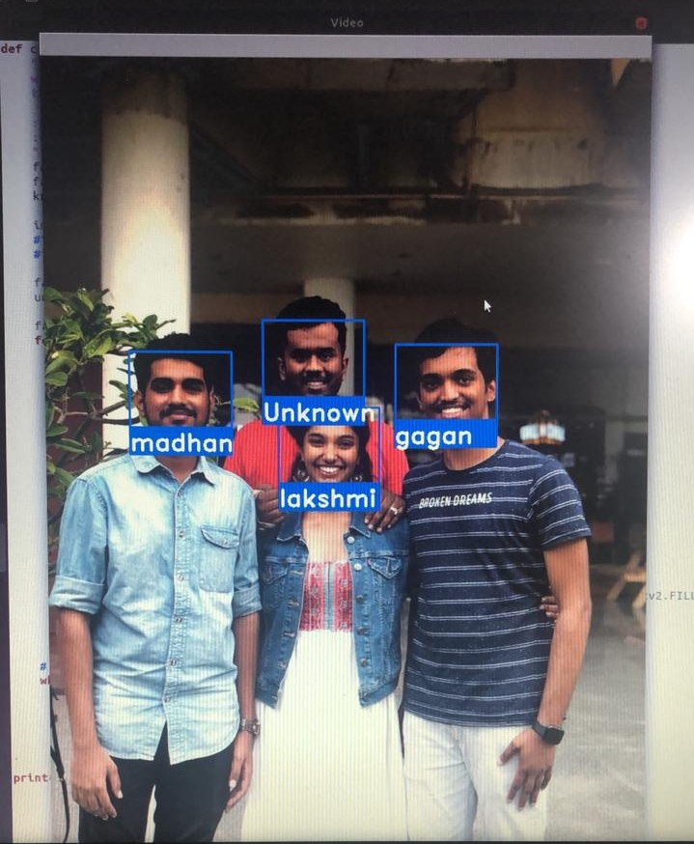
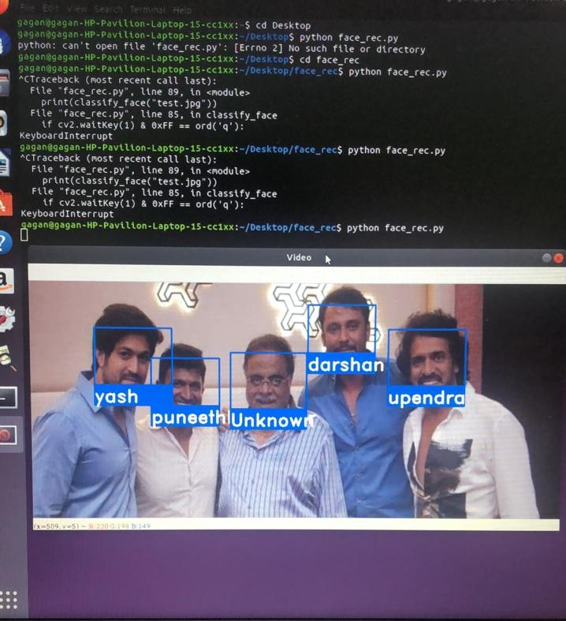
Example

Slide 31
Future Improvements:
Future developments to this could be adding all the names into an excel sheet with a comprehensive system to maintain attendance on a daily. Also, a future improvement could be a real time recognition mechanism that currently is an issue to hardware used in our day to day CCTVs as they are not powerful enough to get the required amount of detail.
Another improvement would be a more direct method to input images into the second program as the current image isn’t the easiest method possible.

Slide 32
Conclusion:
To improve the recognition performance, there are many things that can be improved here, some of them being fairly easy to implement. For example,
you could add color processing(Although OpenCV uses greyscale images) , edge detection, etc.
Possibilities are a million but we require faster and wider implementation of simpler and efficient algorithms like these in everyday life such as to help and improve in multiple sectors such as those mentioned in the problem statement.

Slide 33
Thank you.

